Slide 1
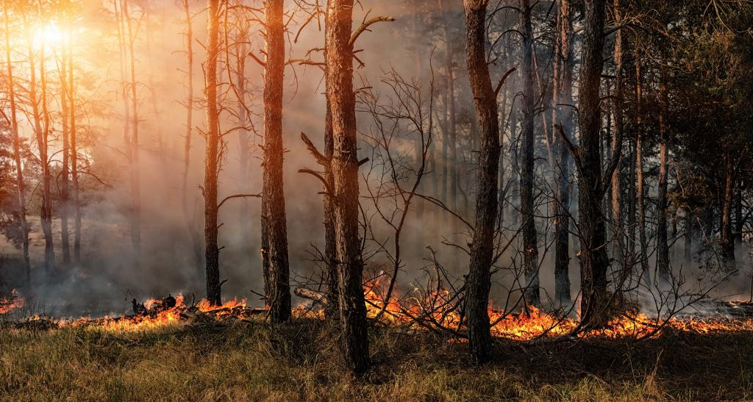

Study of wildfires in the us For the years 1992-2015

Slide 2
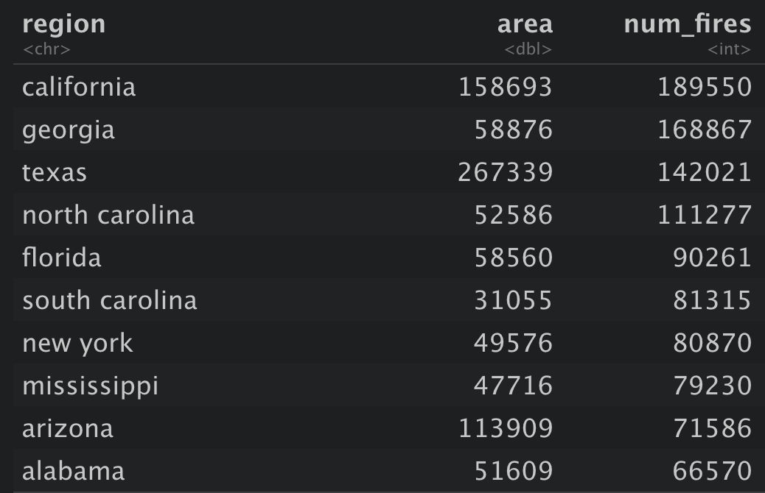
1) Which States have the highest likelihood of a wildfire occurring
Top 3 States with the most total number of fires are:
California
Georgia
Texas
However Georgia is only an average sized state but has a lot of fire
Therefore we shall normalise state size, but calculating number of fires per square mile.

Slide 3
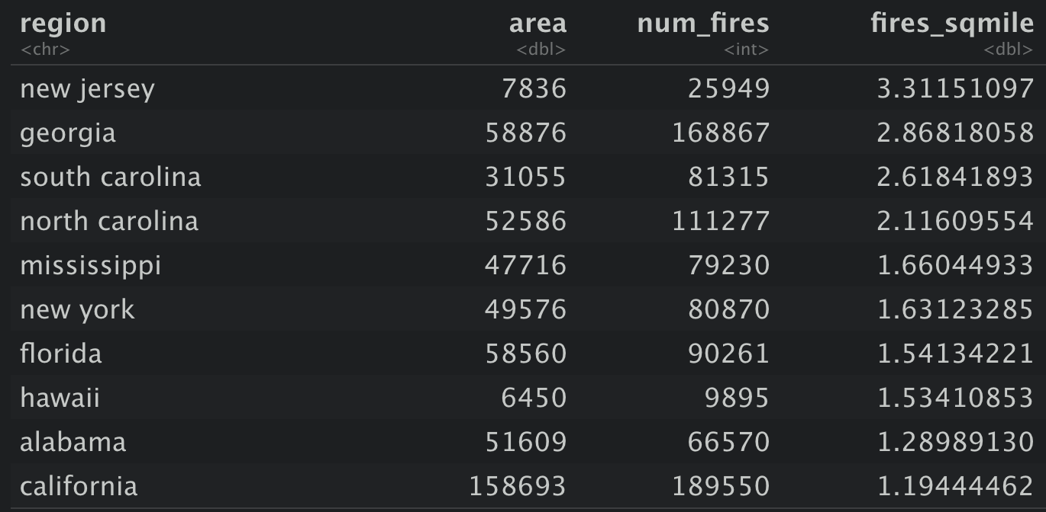
1) Which States have the highest likelihood of a wildfire occurring
Now considering the number of fires per square mile the top 3 are:
New Jersey
Georgia
South Carolina
Texas is not in the top 10 at all and California is only just.
This is a better way of seeing which States have a larger probability of a wildfire.

Slide 4
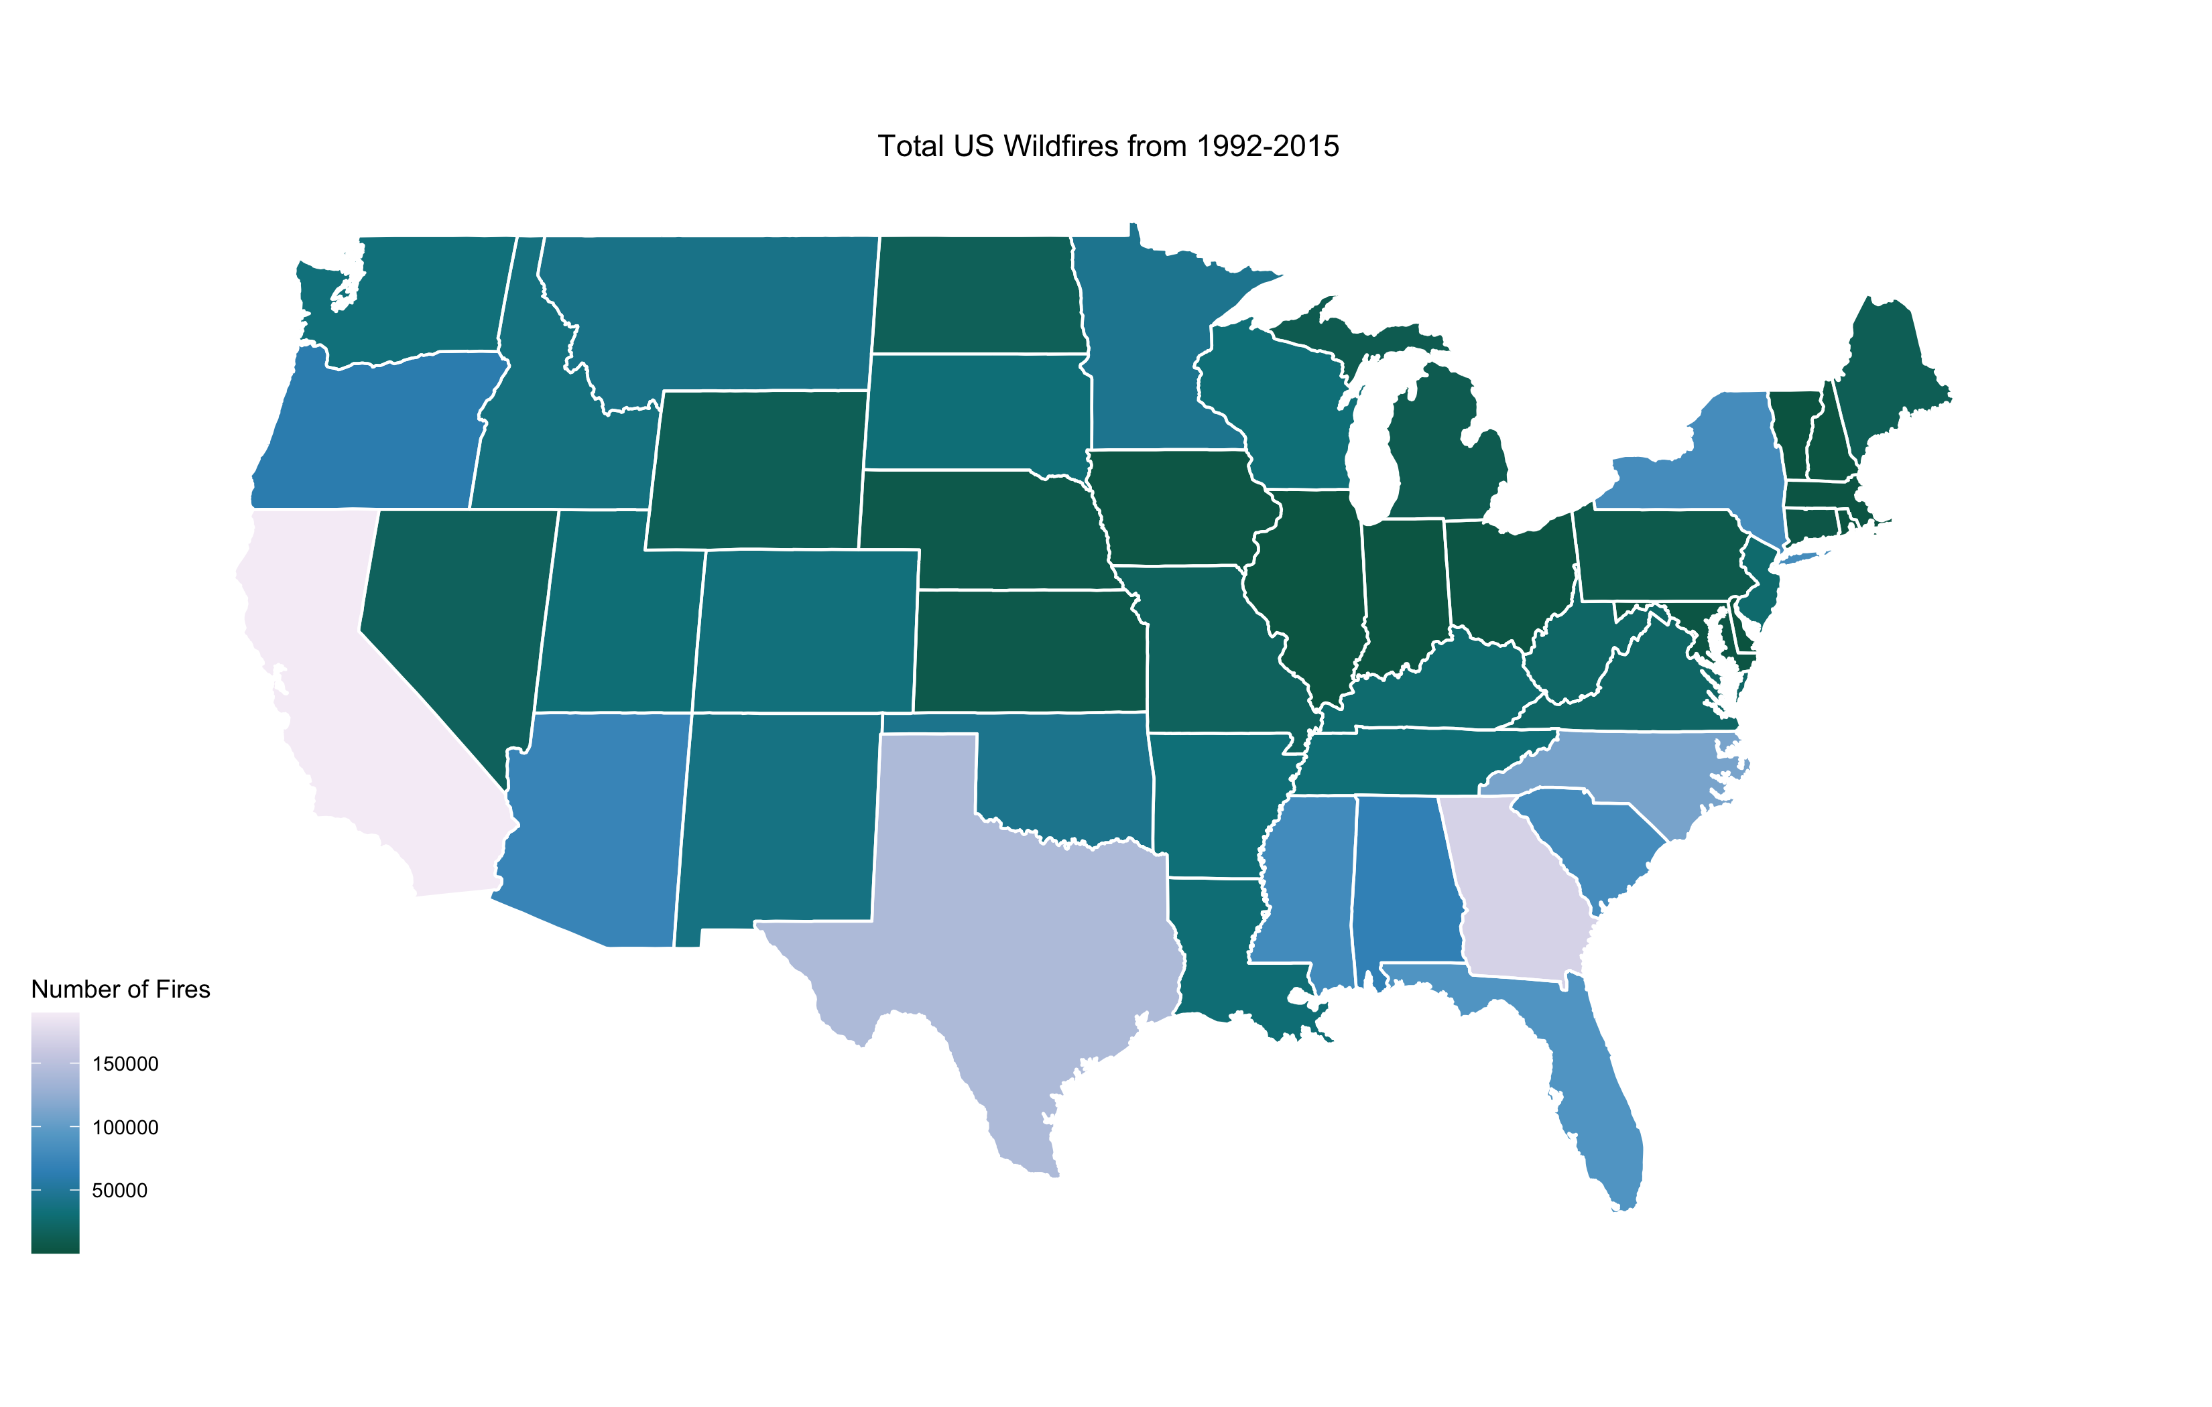
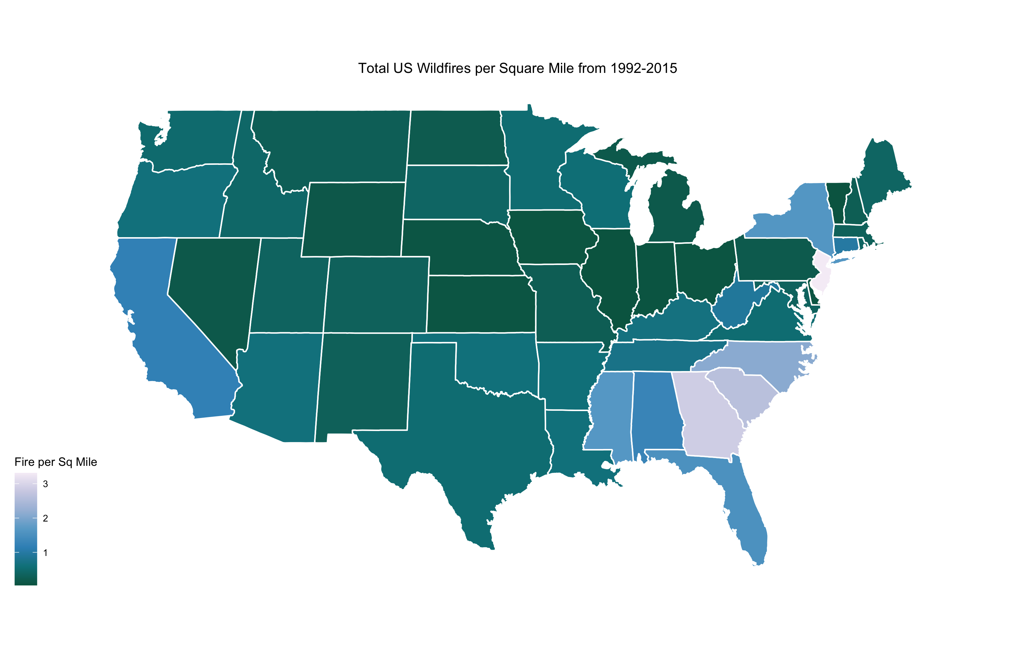
1) Which States have the highest likelihood of a wildfire occurring

Slide 5
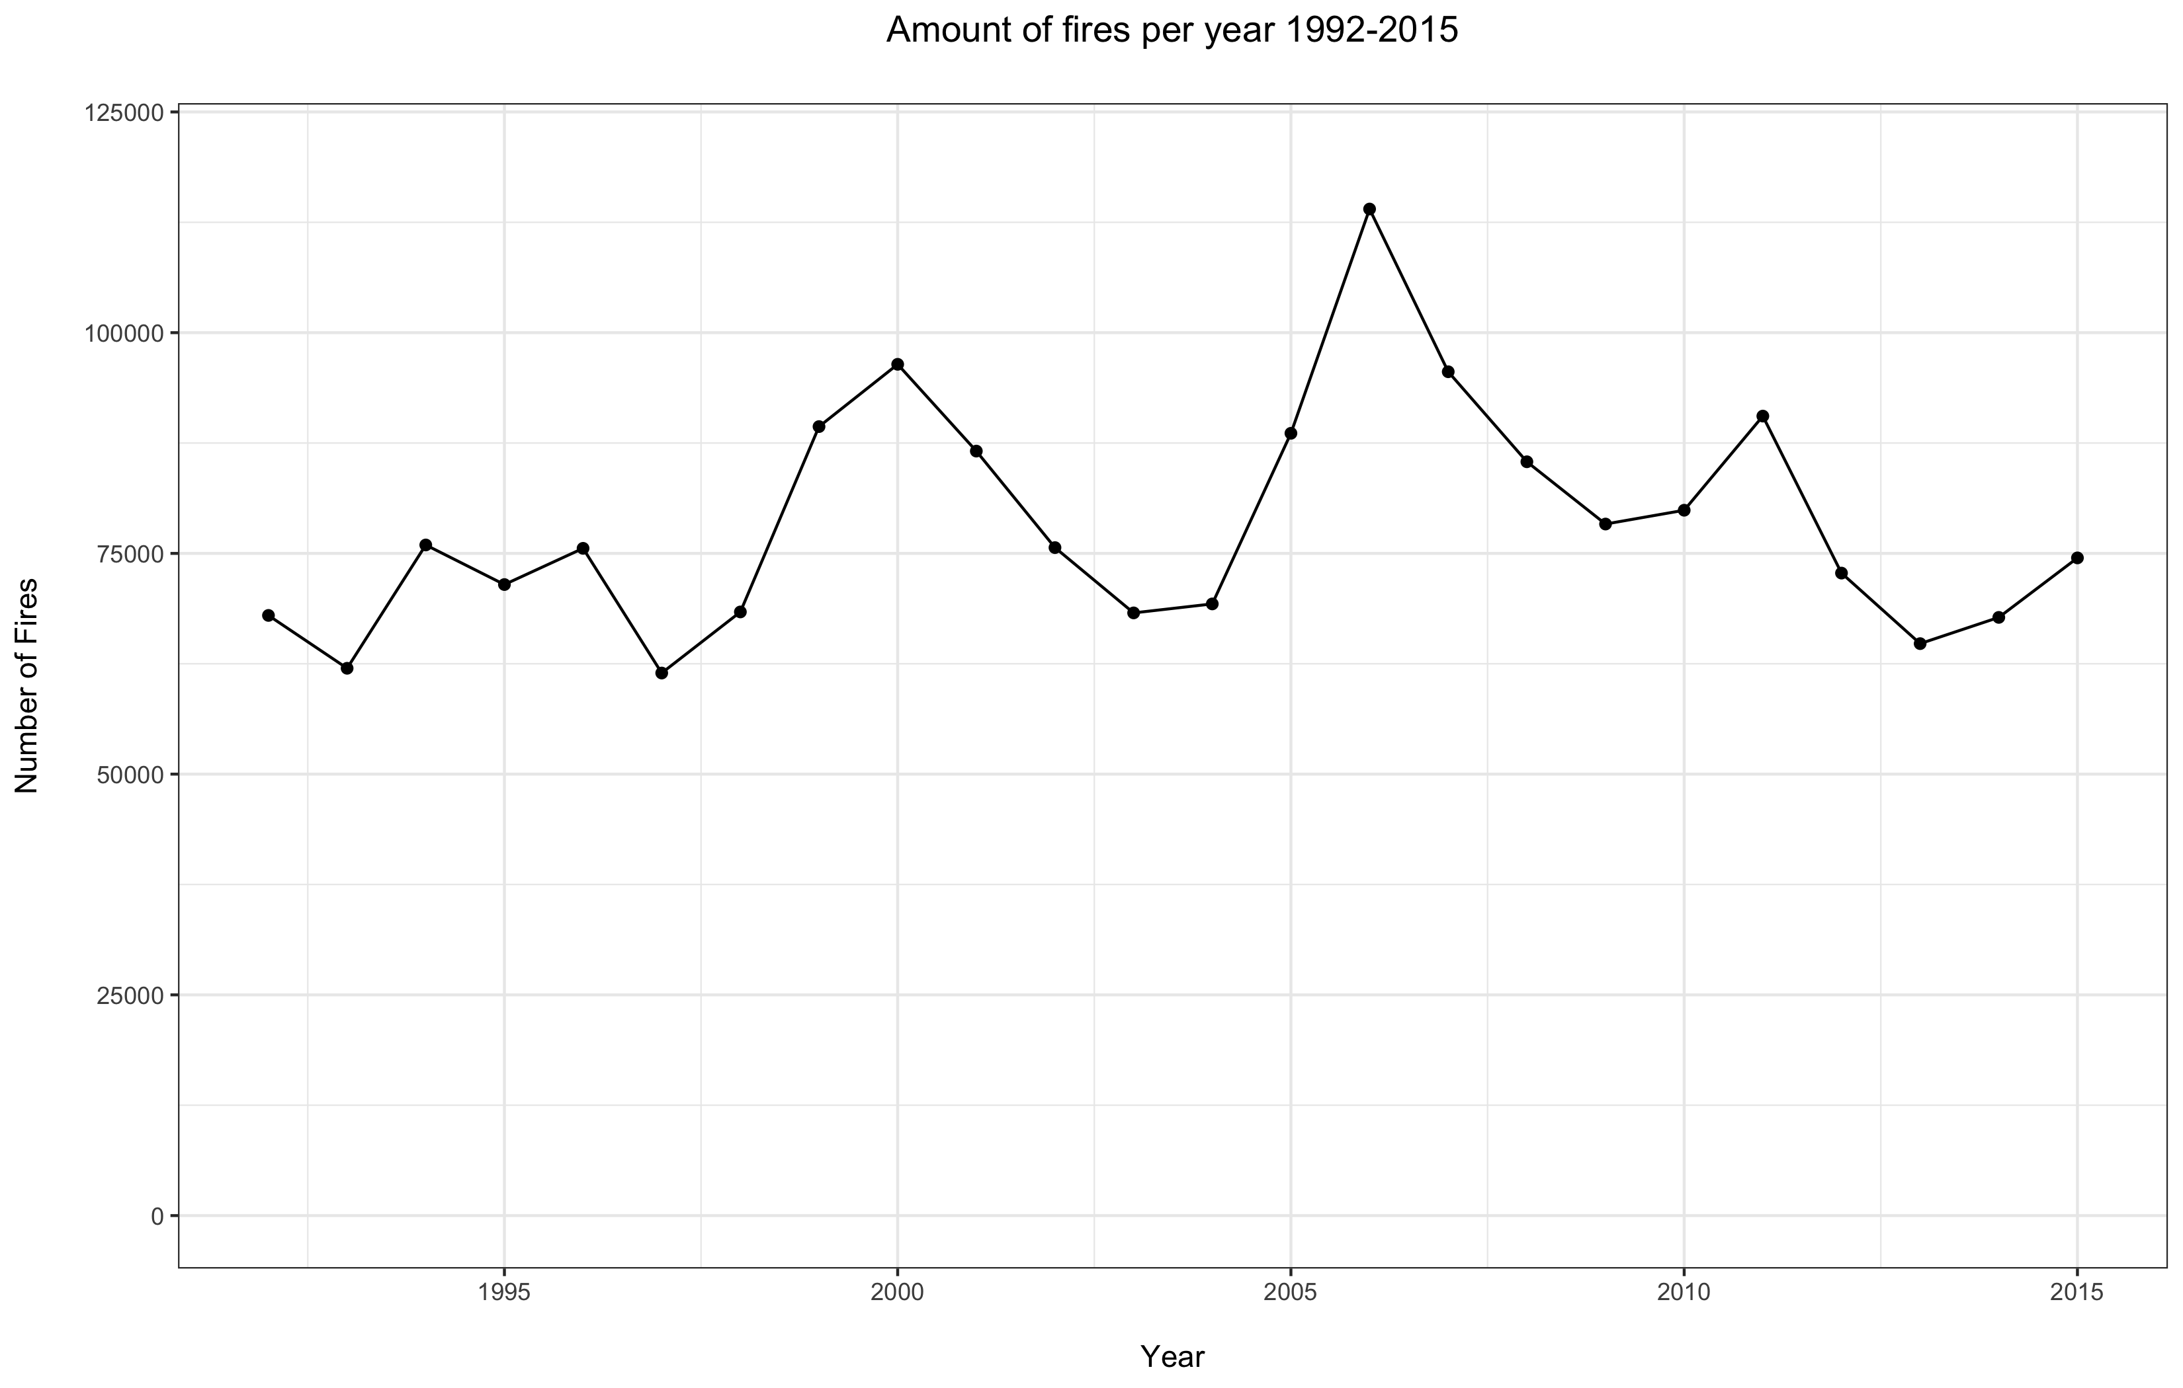
2) Have occurrences of wildfire increased or decreased over the reporting period
From the total number of fires per year, it can be seen that there is a pattern of peaks.
These seem to coincide with recorded heatwaves in North America, although this is not definite proof of the reason for the peaks. ⁽¹⁾
Visually looking at the plot there doesn’t seem to be any overall trend of increase or decrease in the number of fires, but I modelled the data to prove mathematically.
¹⁾ https://en.wikipedia.org/wiki/List_of_heat_waves

Slide 6
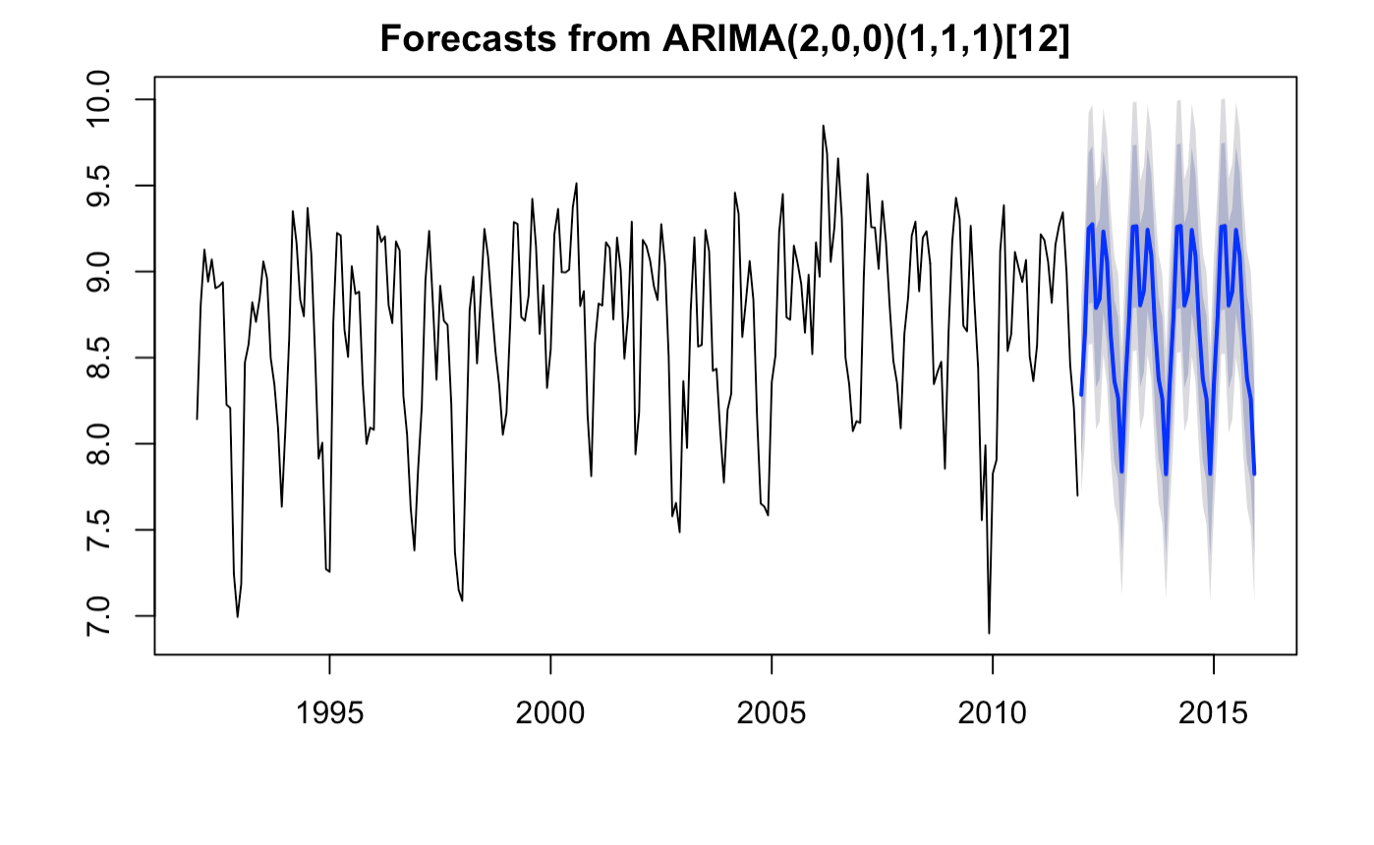
2) Have occurrences of wildfire increased or decreased over the reporting period
In order to get a more accurate picture of any trends present I have plotted the number of fires per month, instead of year
This plot clearly shows a double peak each year, which I intend to investigate later
To validate how accurate the model is I kept the last 4 years separate to compare.
Blue line is the SARIMA model.

Slide 7
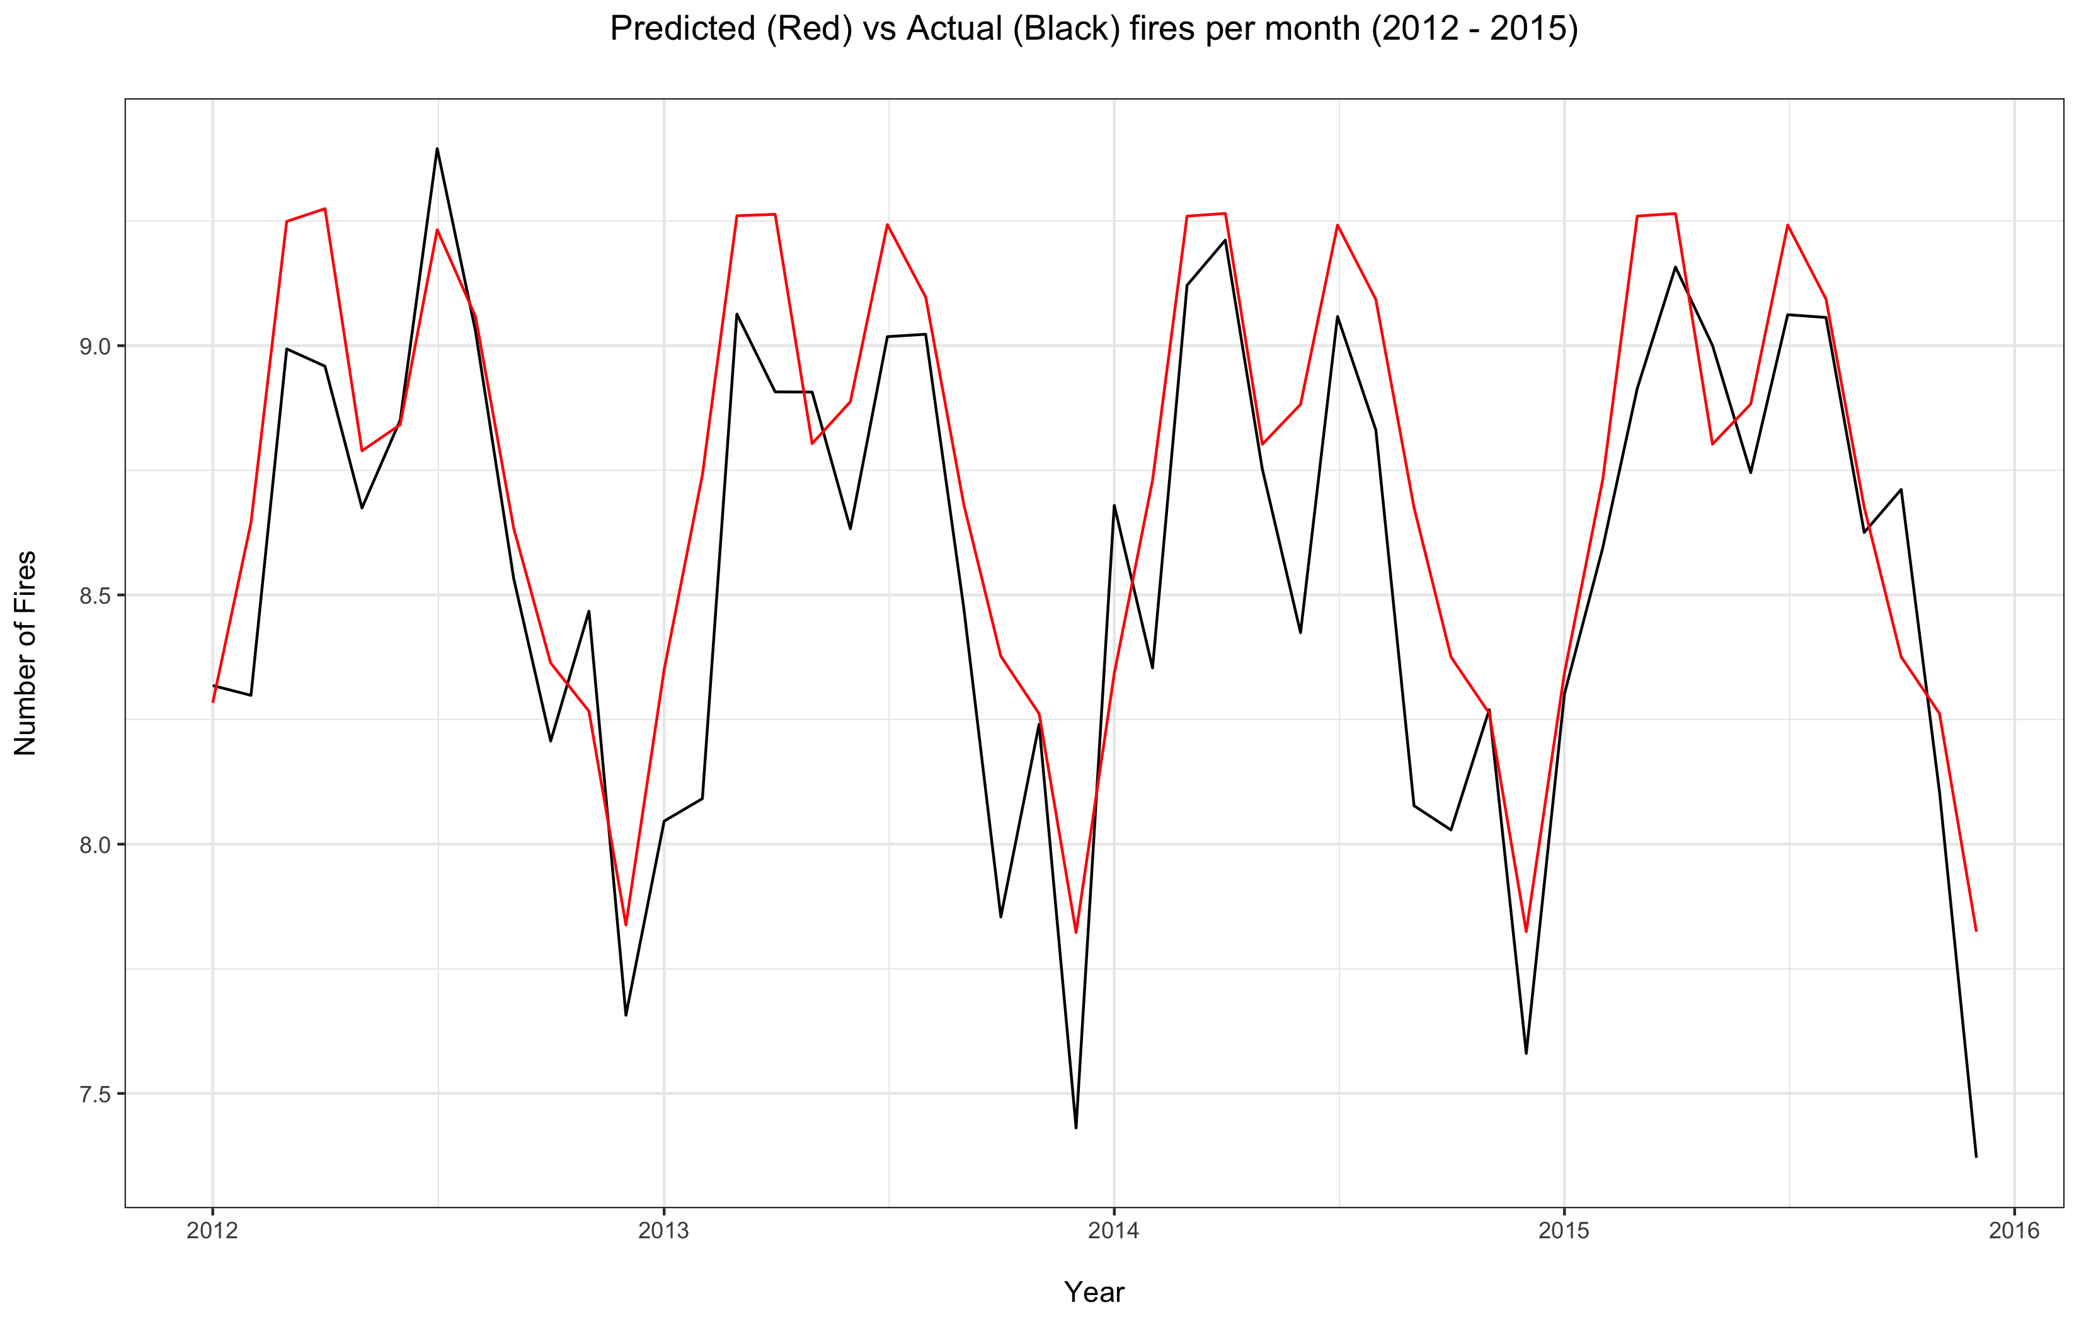
2) Have occurrences of wildfire increased or decreased over the reporting period
This plot shows the accuracy of the SARIMA model, with the predicted data in red versus the actual data in black
The model clearly has understood there is a double seasonal peak in wildfires each year
It was also shown that there has been no statistically significant increase or decrease in wildfires over the reporting period.

Slide 8
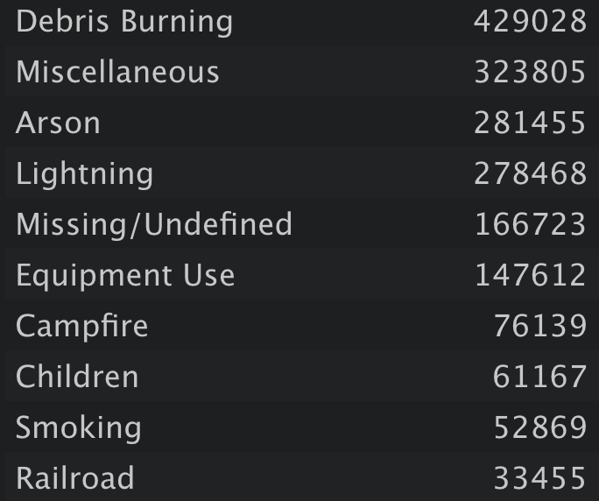

3) What are the main causes of wildfires occurring.
This list shows all the causes of fires record during the 1992-2015 period
Debris burning is the most common cause of fires by over 100,000.
Lightning is shown to be the highest natural cause of fires.

Slide 9
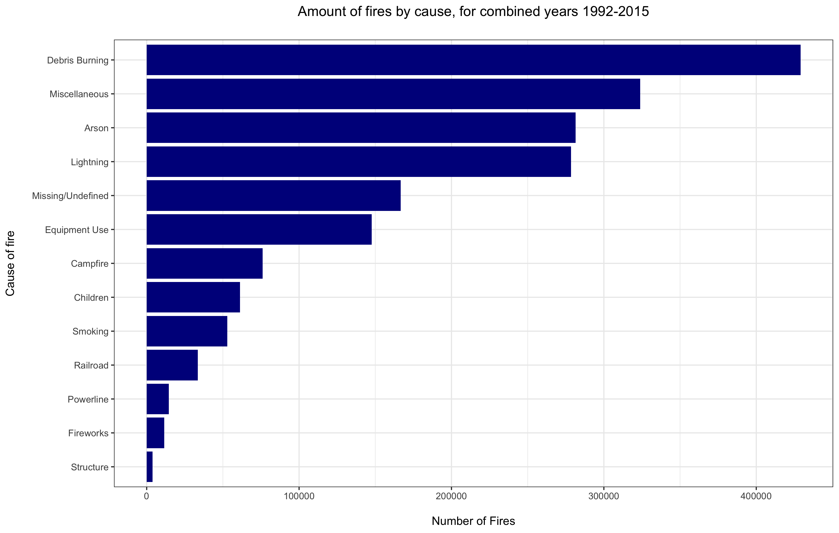
3) What are the main causes of wildfires occurring.

Slide 10
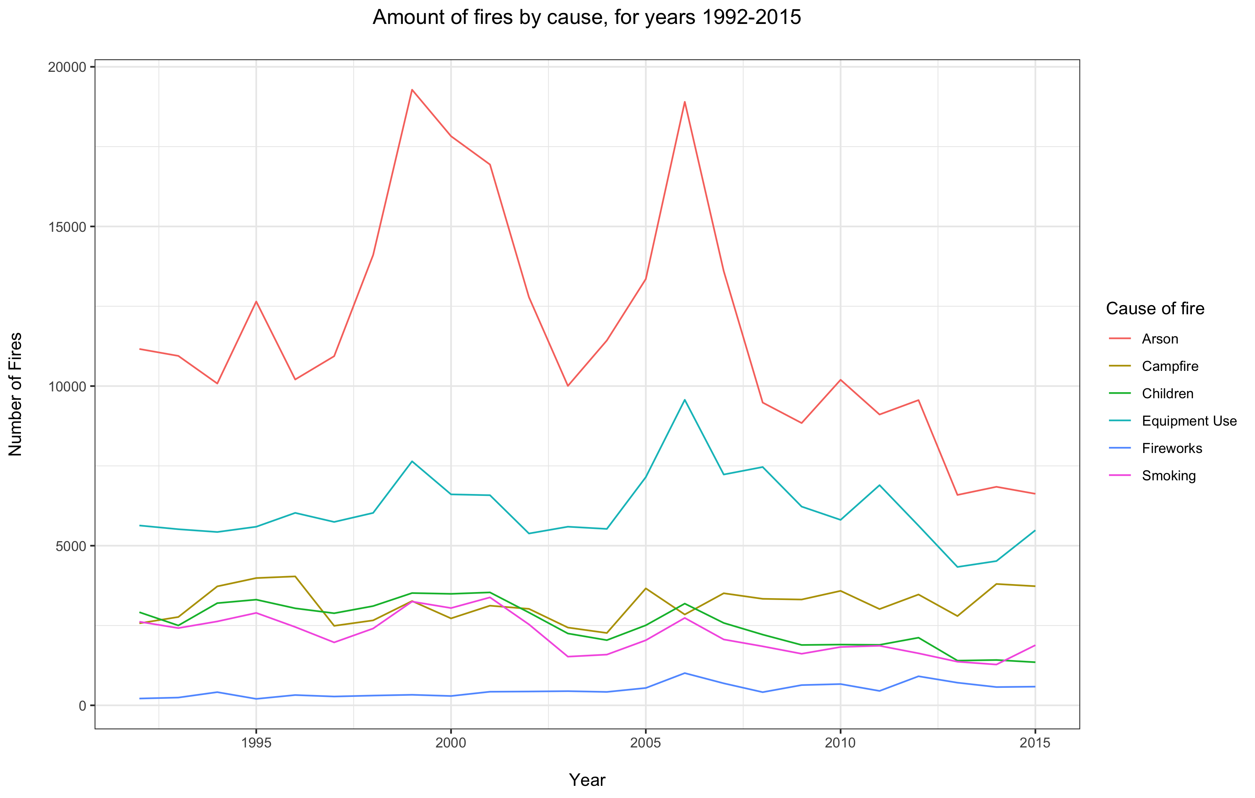
4) Have occurrences of wildfire increased or decreased over the reporting period
For readability the causes have been split into 2 groups.
Arson is clearly the most common cause in group 1.
There are 2 big peaks in 1999 and 2006, both of these coincide with heatwaves in the US. ⁽¹⁾
Although there is no proof to link the heatwave to an increase of arson by itself, it is probable that the unusually warm conditions helped to dry the ground and increase the amount of fuel available for a fire to spread.
The 2006 peak is also seen in Equipment, Children, Smoking and Fireworks.
¹⁾ https://en.wikipedia.org/wiki/List_of_heat_waves

Slide 11
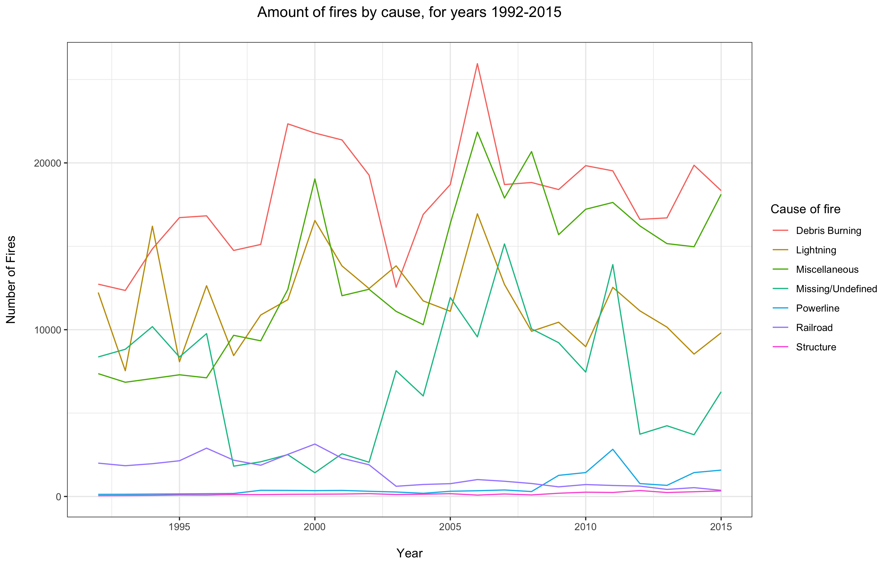
4) Have occurrences of wildfire increased or decreased over the reporting period
Debris burning is the most common cause in group 1.
The peaks in 2000 and 2006 are visible in this plot are well. ⁽¹⁾
There is a defined trough in cases of Missing/Undefined data from 1997 – 2002, with a corresponding increase in Miscellaneous and Lightning.
¹⁾ https://en.wikipedia.org/wiki/List_of_heat_waves

Slide 12
4) Have occurrences of wildfire increased or decreased over the reporting period
Debris burning is the most common cause in group 1.
The peaks in 2000 and 2006 are visible in this plot are well. ⁽¹⁾
There is a defined trough in cases of Missing/Undefined data from 1997 – 2002, with a corresponding increase in Miscellaneous and Lightning.
¹⁾ https://en.wikipedia.org/wiki/List_of_heat_waves

Slide 13
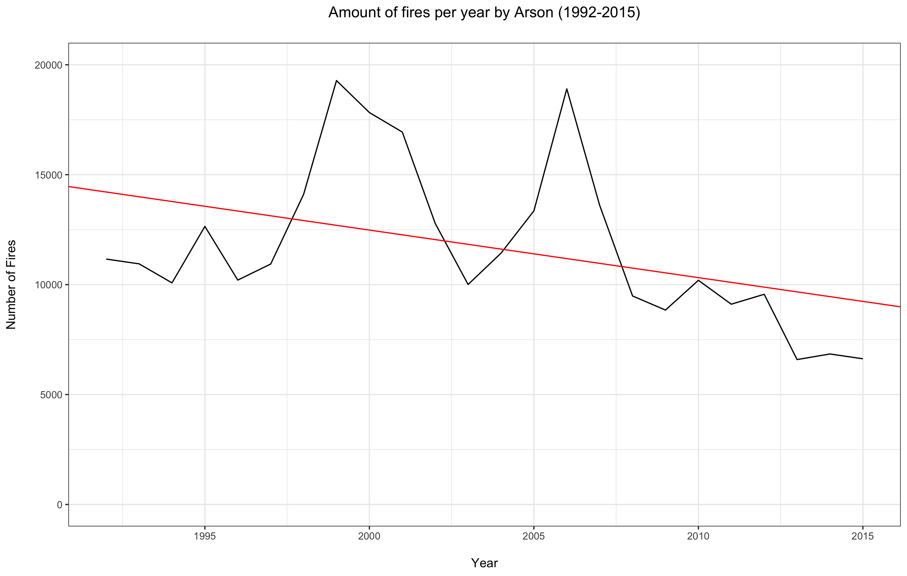
4) Have occurrences of wildfire increased or decreased over the reporting period
A linear model was applied to the arson data and it has been shown that there has been statistically significant decrease of fires due arson over the reporting period.

Slide 14
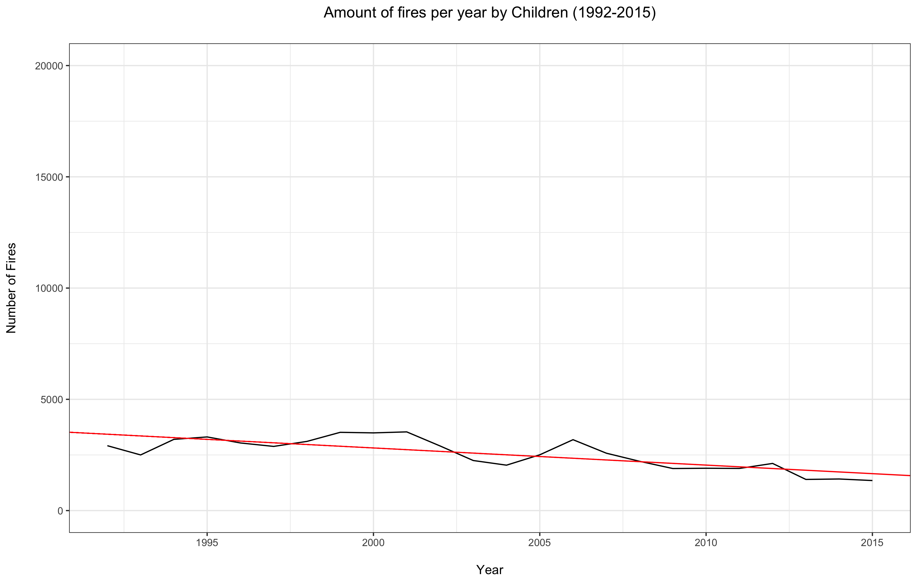
4) Have occurrences of wildfire increased or decreased over the reporting period
A linear model was applied to the children cause data and it was also shown that there has been statistically significant decrease of fires due children over the reporting period.
Other causes were shown to have not changed significantly over the reporting period.

Slide 15
Which States have the highest likelihood of a wildfire occurring
Top 3 States with the most total number of fires are:
California
Georgia
Texas
However Georgia is only an average sized state but has a lot of fire
Therefore we shall normalise state size, but calculating number of fires per square mile.

